Slide 1

Cement and Its Manufacture

Slide 2






Cement & Its History
Manufacturing Overview
Cement
Manufacturing Process
National Scenario
Manufacturers & Challenges
CONTENTS
Ways to Cope With Challenges

Slide 3

01
Cement &
Its History

Slide 4



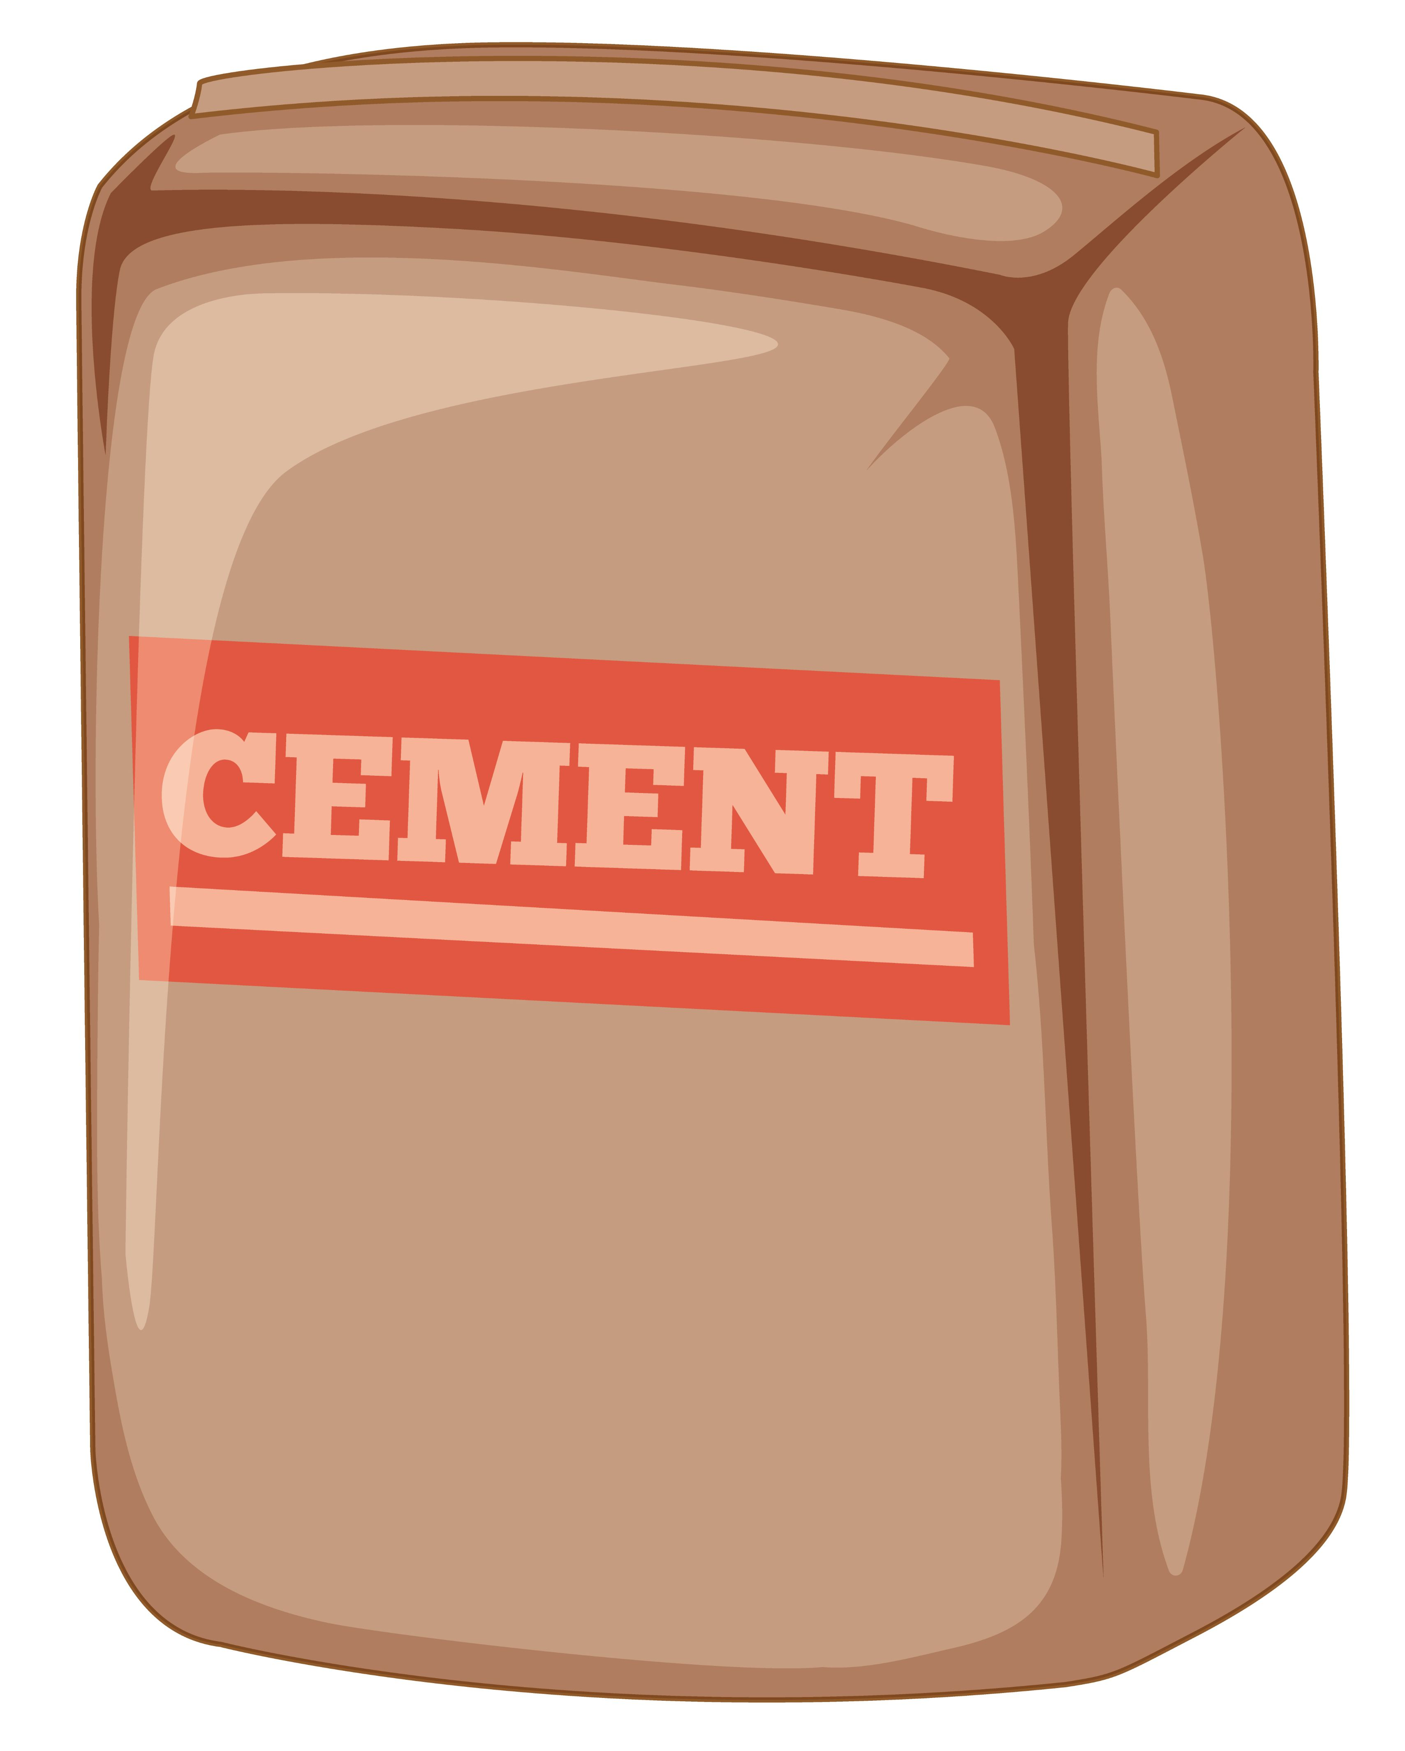
What is Cement?
Cement is a fine powder made from limestone, clay, and other minerals, which is mixed with water to form a paste. When the paste is mixed with sand and aggregate (gravel, rocks, etc.), it forms concrete, which is a construction material that is widely used in buildings, bridges, roads, and other structures.
Cement is the key ingredient in concrete that gives it its strength and durability. It is produced in large quantities at cement plants, which grind the raw materials and heat them in a kiln to produce the finished product. Cement is commonly used in the construction industry to make mortar and grout as well.

Slide 5


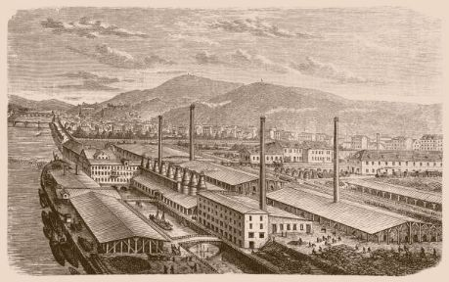
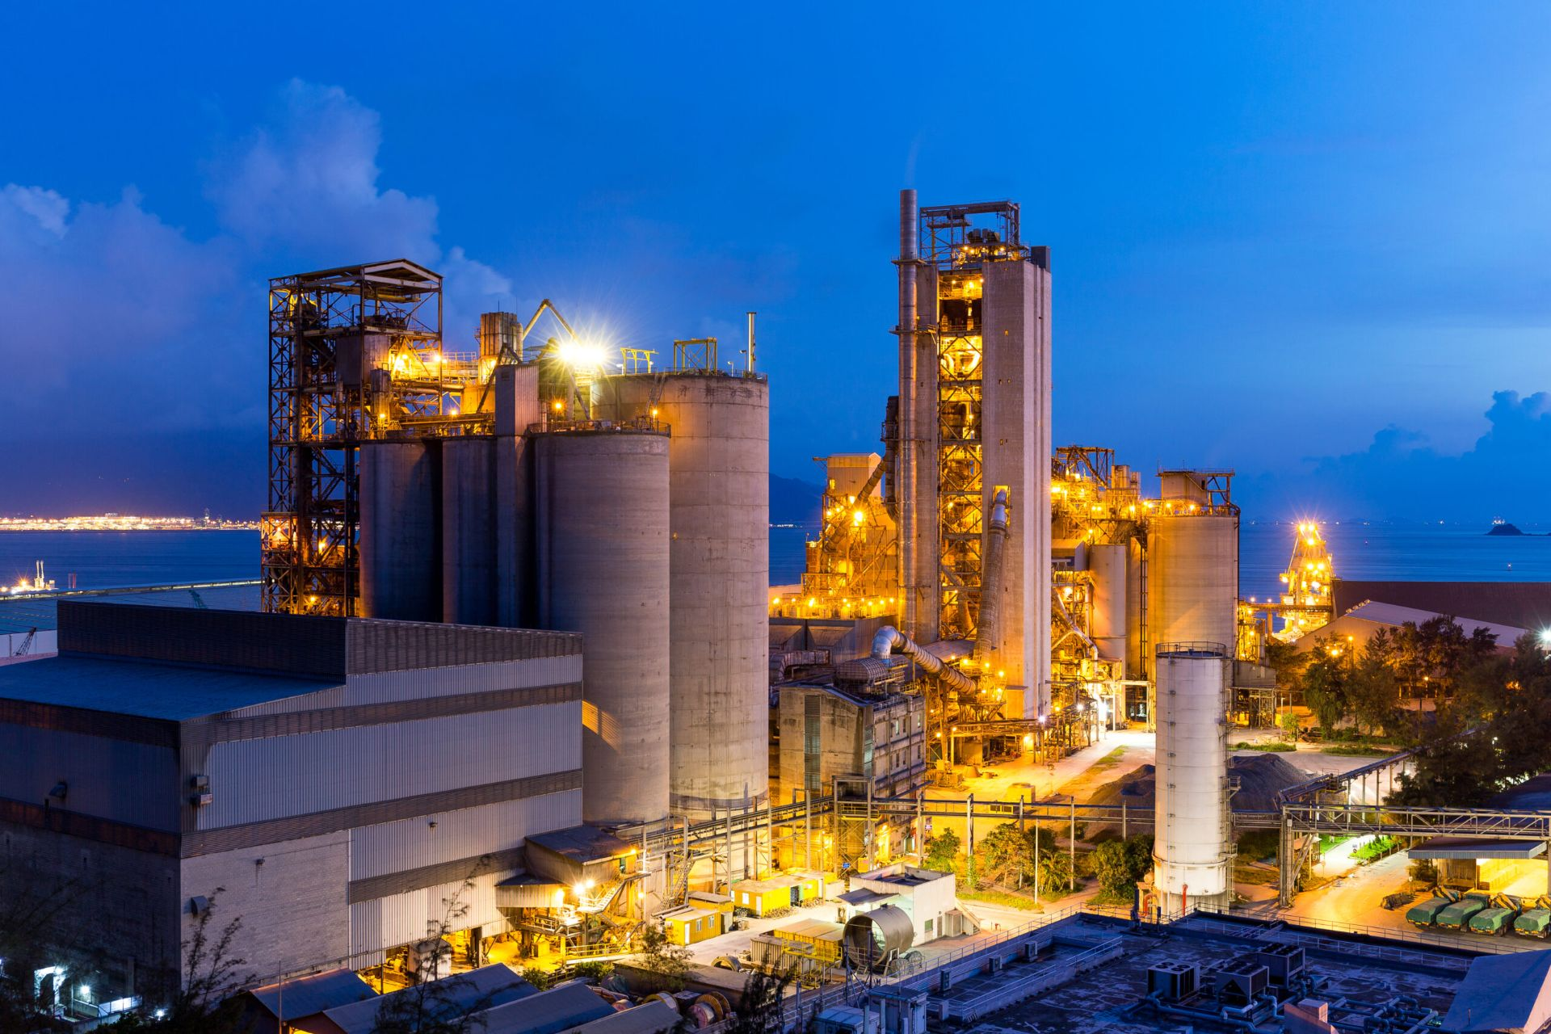

Cement is a crucial construction material that has been used for thousands of years. The history of cement dates back to ancient civilizations, and its development has played a significant role in shaping the modern world.
The earliest known use of cement dates back to the ancient Egyptians, who used a type of cement called "gypsum cement" to build the pyramids. The ancient Romans also used cement in their construction projects, and the Romans are credited with developing a type of cement called "hydraulic cement." This type of cement hardens when mixed with water, making it an ideal material for constructing buildings, roads, and other structures.
History
During the Industrial Revolution, cement production saw significant advancements. In the early 19th century, a British bricklayer named Joseph Aspdin invented Portland cement, which is still used widely today. Portland cement is made by heating limestone and clay together, and it is known for its strength and durability.
In the 20th century, cement production continued to evolve, with the development of new types of cement and new manufacturing methods. Today, cement is used in a wide range of construction projects, from small residential buildings to massive infrastructure projects.
Overall, the history of cement is a long and fascinating one, with significant developments occurring throughout the centuries. From its early use in ancient civilizations to its modern applications in construction, cement has played a vital role in shaping the world we live in today.

Slide 6

02
Manufacturing
Overview

Slide 7




The manufacturing of cement involves several steps, including mining and quarrying raw materials, crushing and grinding the raw materials, and heating and cooling the resulting clinker. The process of cement manufacturing is energy-intensive, and it is responsible for a significant portion of the world's greenhouse gas emissions. However, advancements in technology and manufacturing processes have helped to reduce the environmental impact of cement production.
Manufacturing Overview
In this section of presentation, we will provide an overview of the cement manufacturing process, including overview of the various steps involved and the raw materials used. So, let's start by understanding the raw materials used in cement manufacturing.

Slide 8

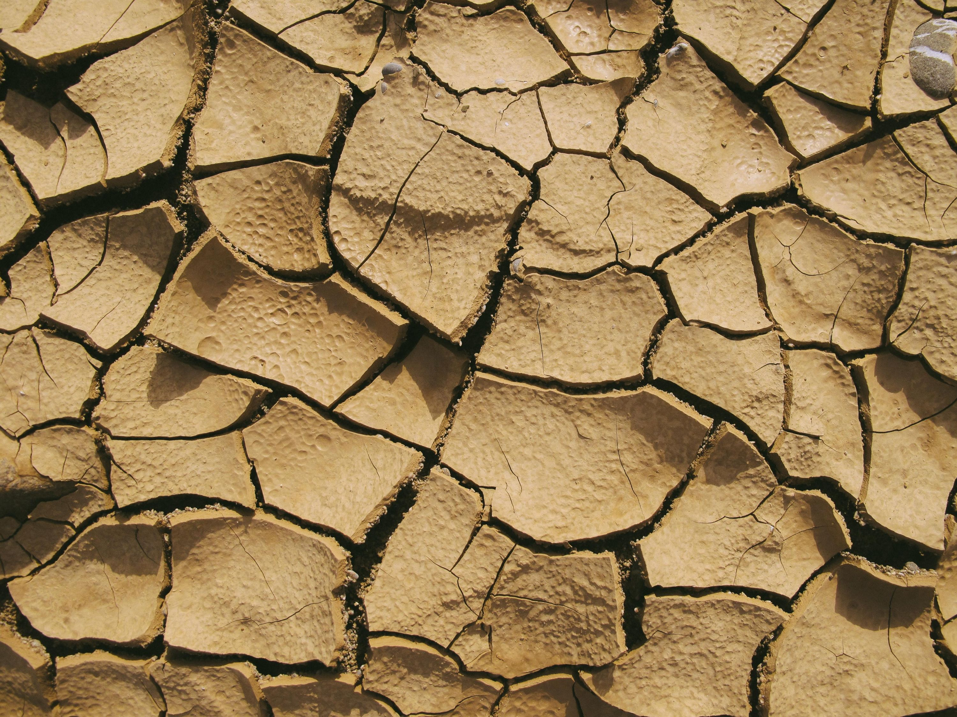



Raw
Materials

Slide 9


Raw Materials
The raw materials used in the production of cement are:
Silica
Gypsum
1. Calcareous materials(which supply lime): Eg. limestone, cement rock(a soft argillaceous limestone), chalk, clay/marl, or marine shales and waste calcium carbonate from industrial process.
2. Argillaceous materials(which supply silica(SiO₂), aluminates(Al₂O₃), and iron oxides (Fe₂O₃)): Eg. clay, ashes, blast furnace slag.
3. Gypsum (CaSO₄.2H₂O)
Clay
Limestone
Now, let's move on and see the overview of the cement manufacturing process.

Slide 10


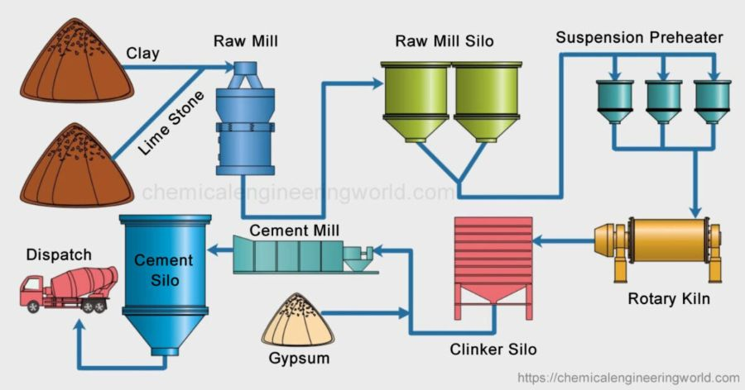
Overview of Cement Manufacturing Process
Grinding, blending and homogenization
Storing clinker and grinding
Quarrying
Crushing
Pyro Processing
Now, let’'s see each step in detail.

Slide 11

03
Manufacturing
Process

Slide 12

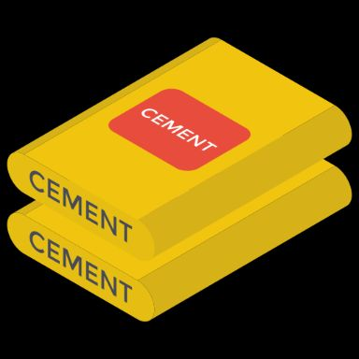


In the previous section, we have seen an overview of the manufacturing process of cement.
Manufacturing Process
Before seeing all processes in detail, let’s see about the types of cement.

Slide 13
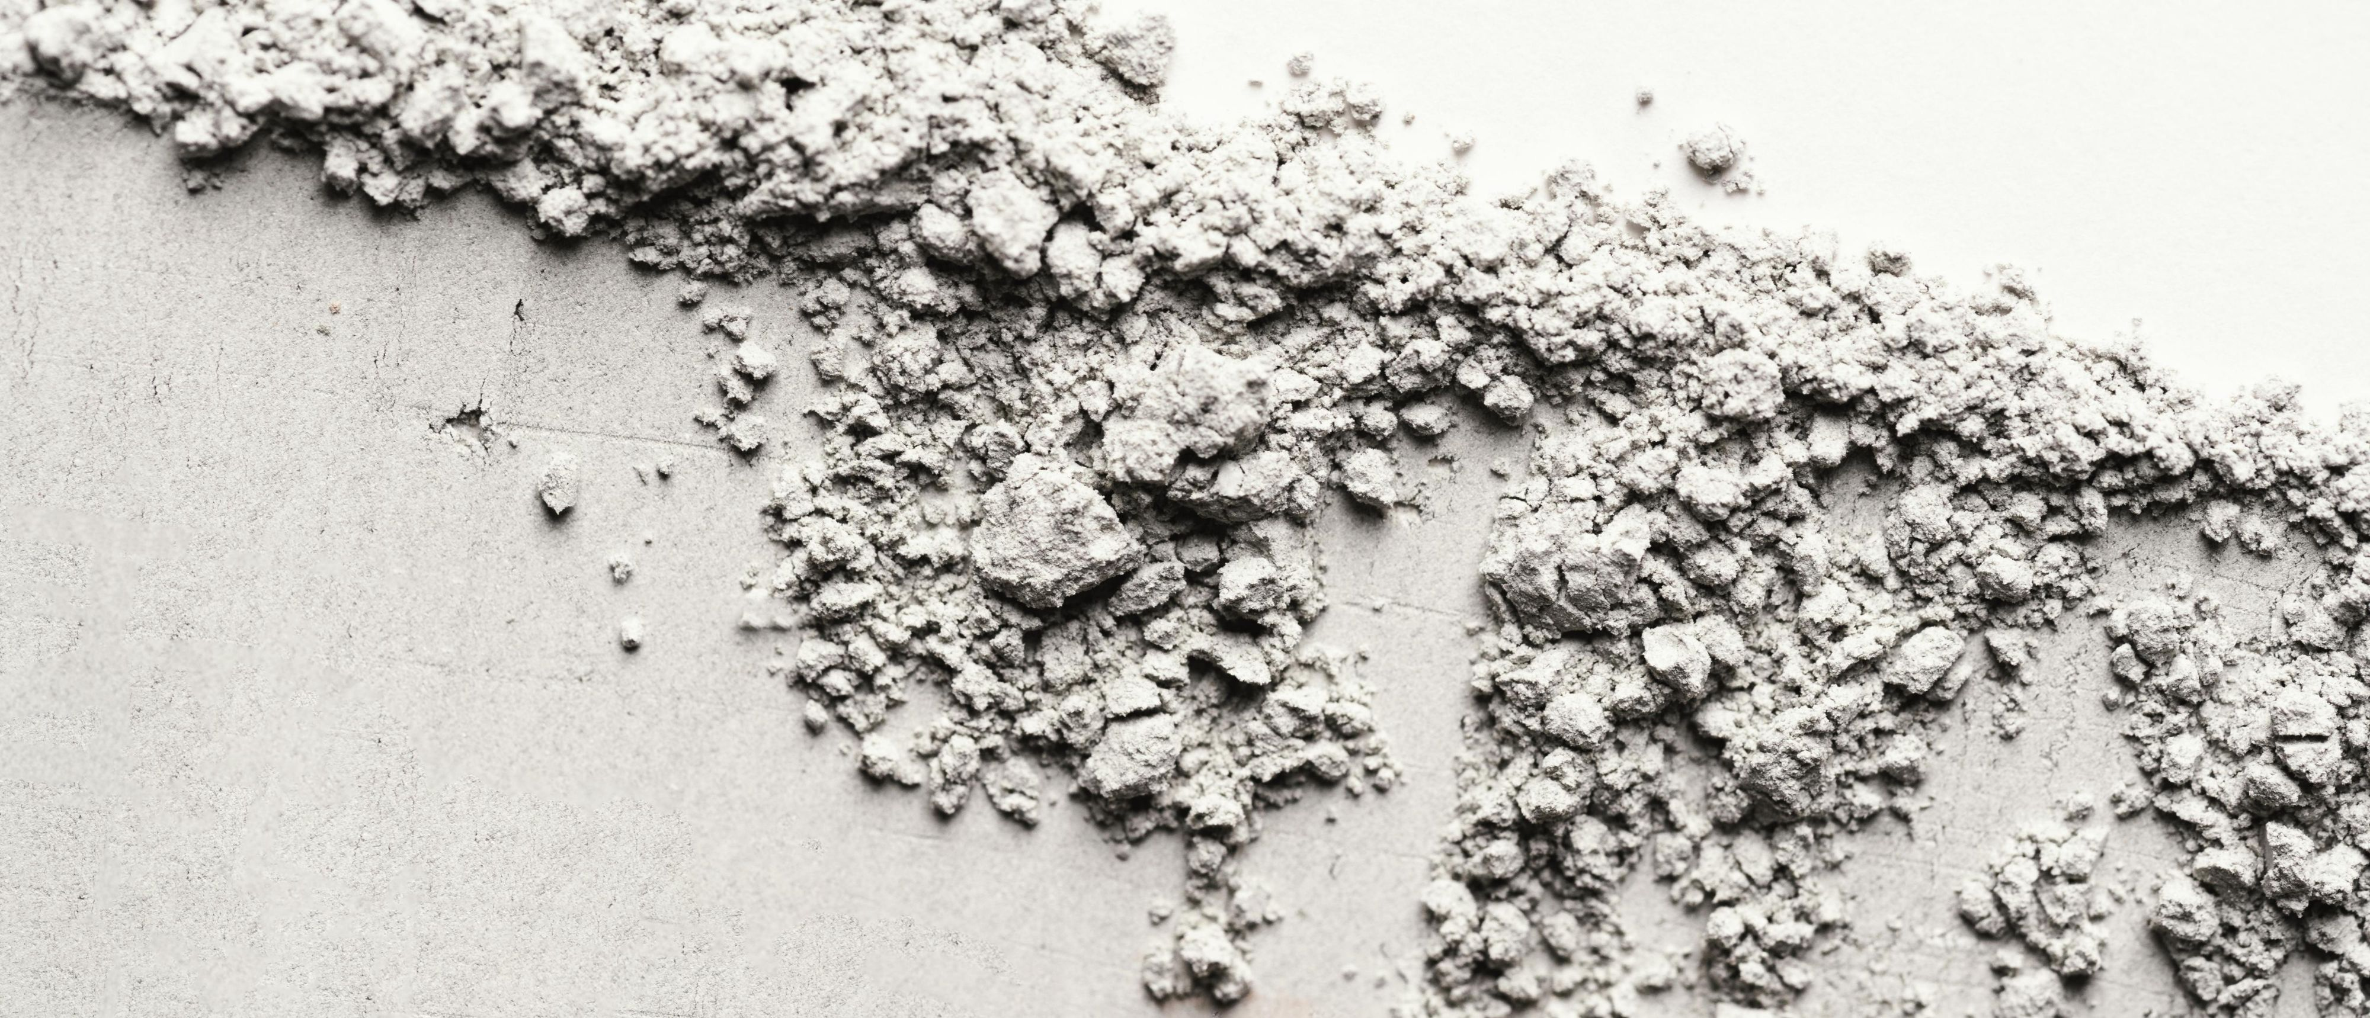
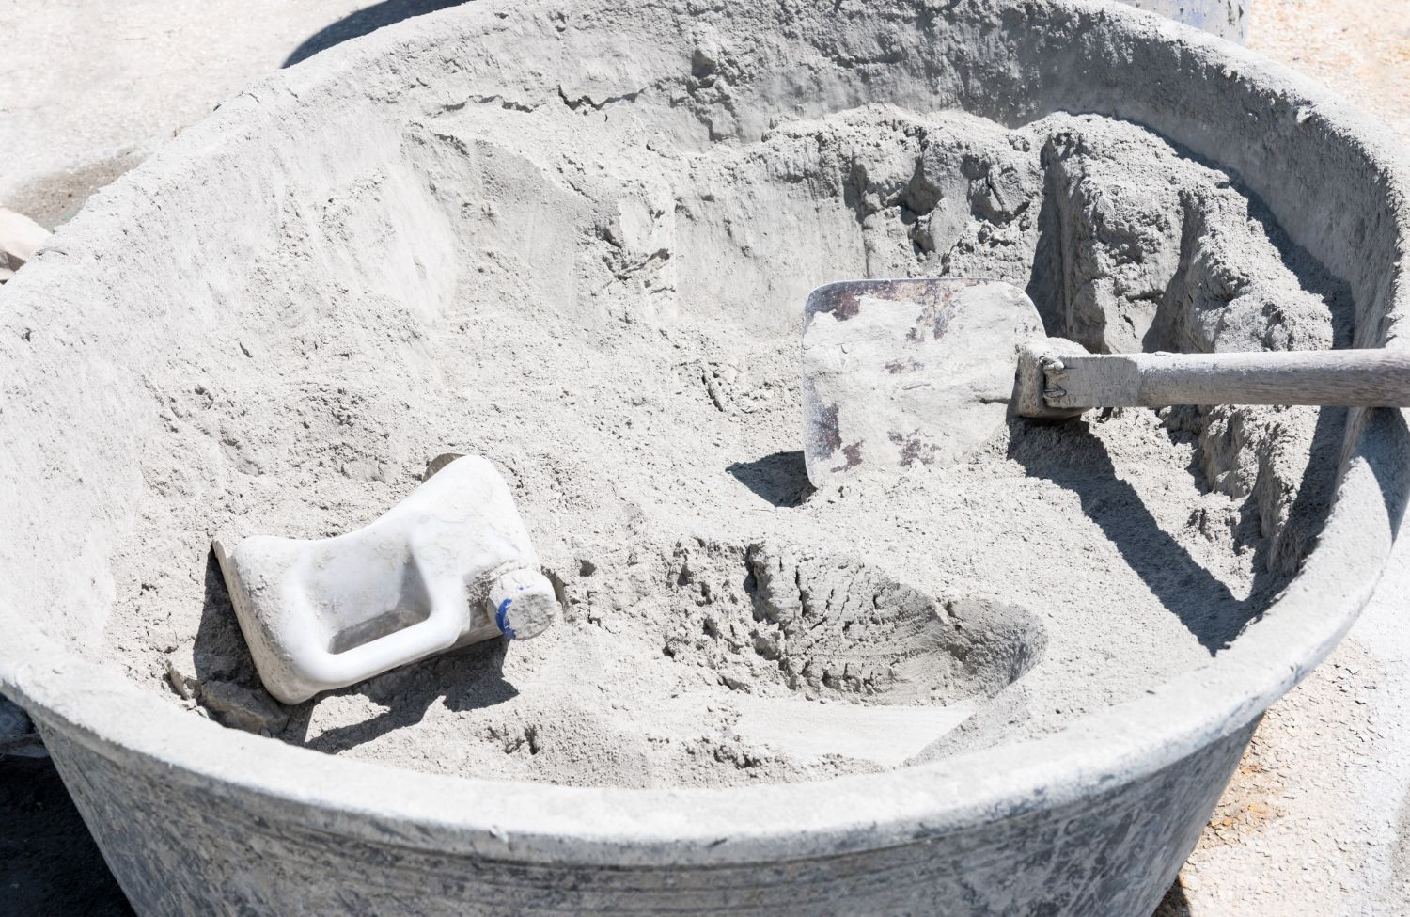
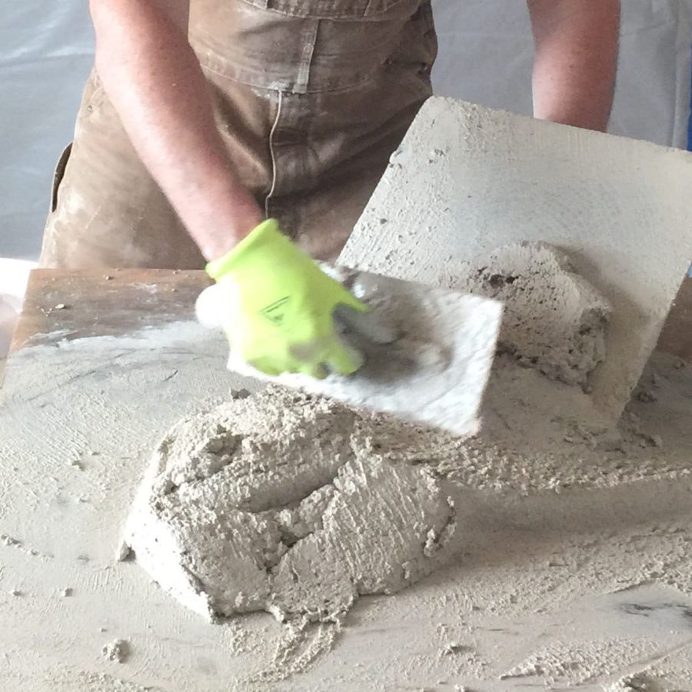
Types
Of
Cement

Slide 14








Types Of Cement
Cement is indeed categorized in various ways, depending on its properties and intended use.
Ordinary Portland cement (OPC) is the most commonly used type of cement, and it is suitable for a wide range of applications.
Portland pozzolana cement (PPC) is a type of cement that is made by adding pozzolana, a volcanic ash, to the mix. This type of cement is known for its high strength and durability.
Ordinary Portland Cement (OPC)
Portland Pozzolana Cement (PPC)
White cement is a type of cement that is made using raw materials that are free of iron oxide and other impurities, resulting in a cement that is white in color.
Types
Of
Cement
High alumina cement is a type of cement that is made using bauxite and other materials high in alumina content. It is known for its high heat resistance and is often used in the construction of furnace linings and other high-temperature applications.
Hydraulic lime is a type of lime that sets and hardens when it comes into contact with water. It is often used in the construction of older buildings and is known for its ability to self-heal cracks.
High Alumina Cement
&
Hydraulic Lime
White Cement

Slide 15







It is tough to learn about manufacturing process of all types of cement in this short period of time we have.
As Ordinary Portland Cement (OPC) and Portland Pozzolana Cement (PPC) are widely used for construction purposes because of their low cost and widespread availability of the limestone, shales, and other naturally-occurring materials used in them, they are one of the lowest-cost materials for construction works. So we are going to see how these types of cement (commonly known as portland cement) are manufactured in factories.
So now what?

Slide 16

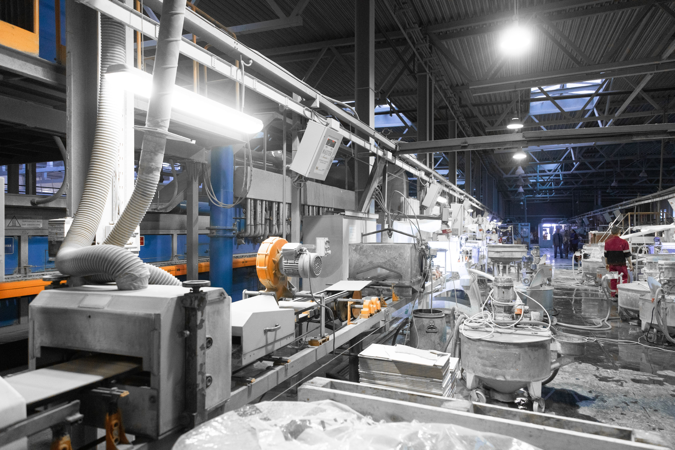
Manufacture
Of
Portland Cement

Slide 17


Portland cement is a type of hydraulic cement, which means that it hardens when mixed with water. It is commonly used as a binding material in construction and is made by heating a mixture of limestone and clay in a kiln to a high temperature, then grinding the resulting clinker to a fine powder.
Raw Material Proportioning
Raw Material Grinding and Blending
Kiln Operation
Clinker Cooling
Manufacturing Process
This is a detailed overview of manufacturing Portland cement.
Let’s look at this diagram and learn what steps are involved in the manufacturing process of Portland Cement.
We will discuss each step after a while.
Clinker Grinding
Crushing
and
Pre-homogenization
Cement Packaging and Shipping
Quarrying

Slide 18
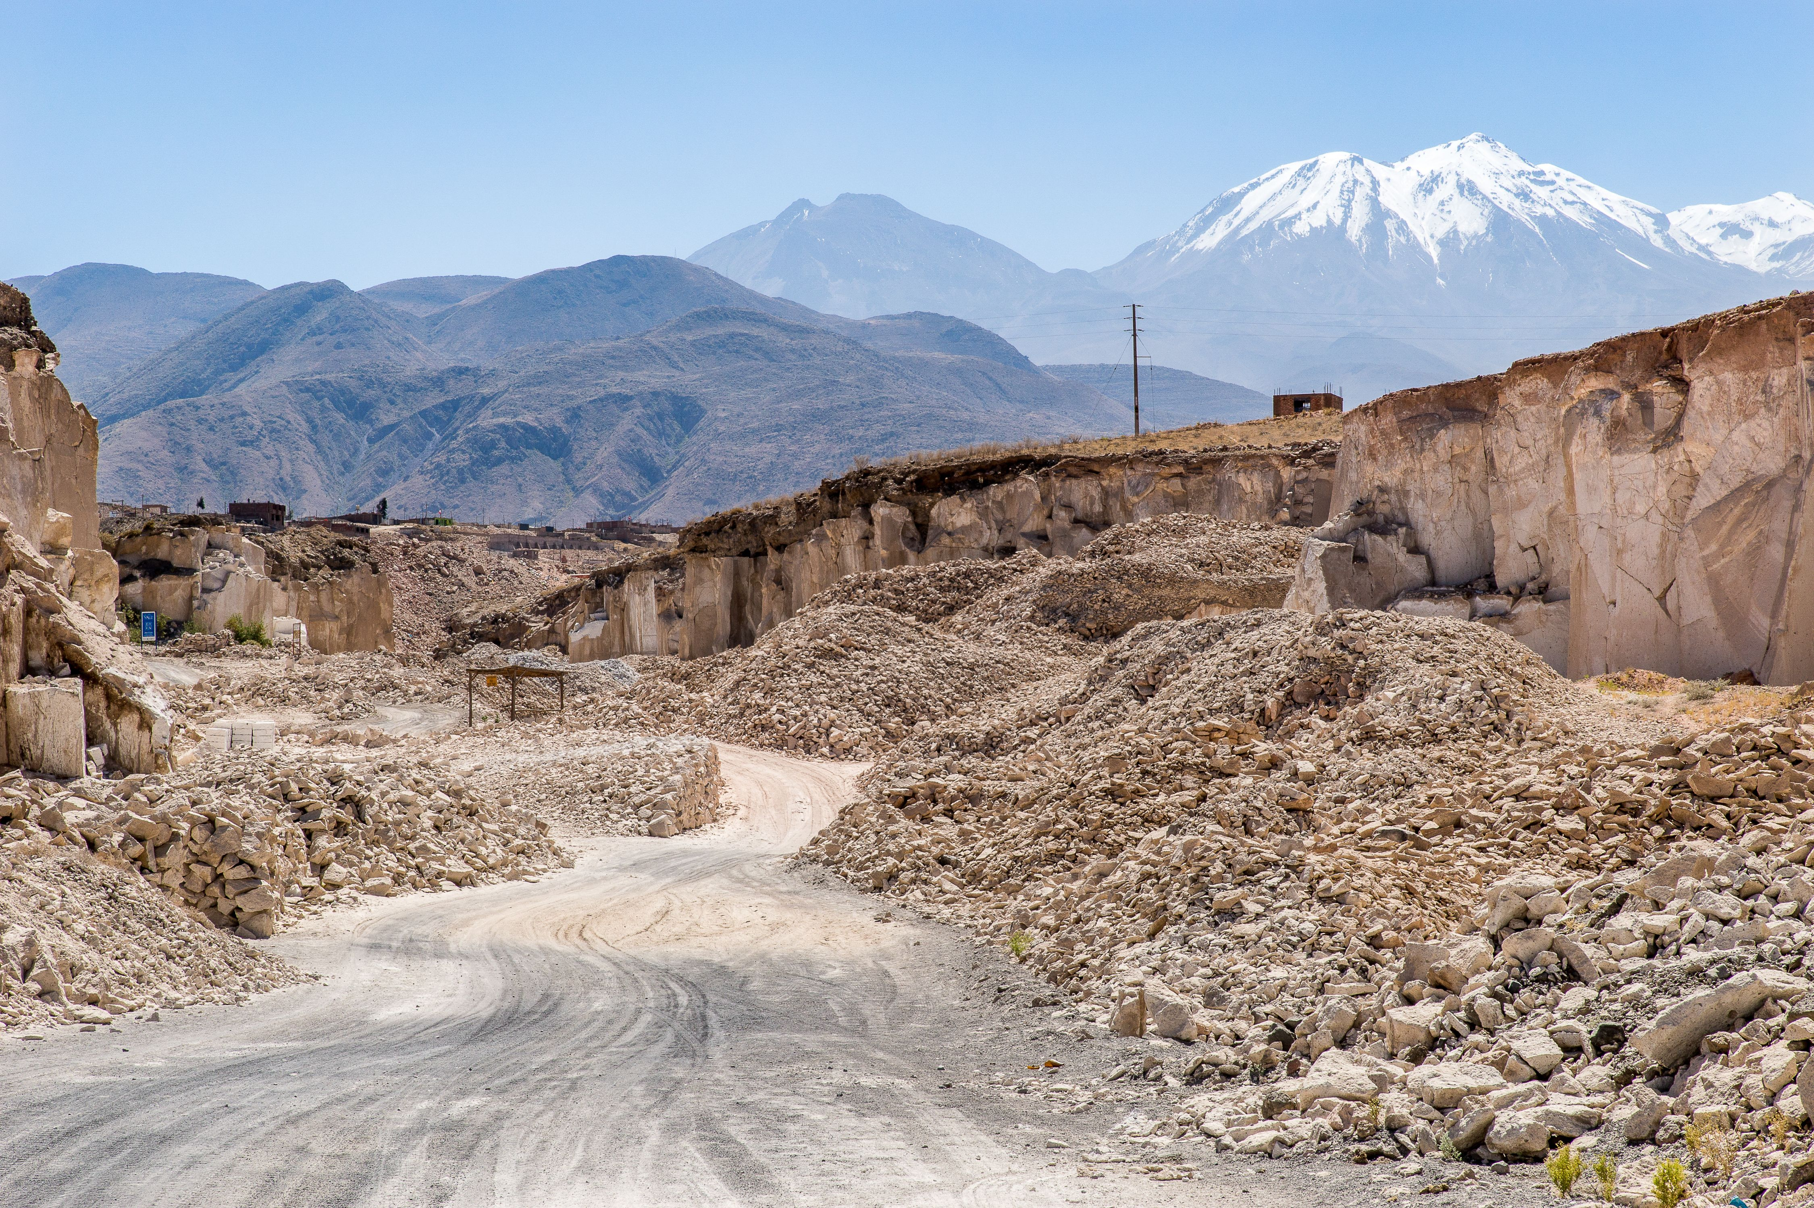

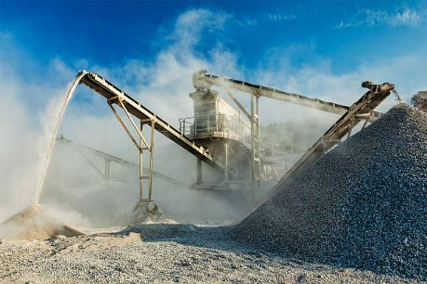
The first step in the cement manufacturing process is to quarry the raw materials, which consist of limestone, clay, and other materials. These raw materials are extracted from the quarry, usually by blasting or drilling, and then transported to the cement plant.
The quarrying process typically involves drilling and blasting to loosen the raw materials from the earth, and then loading them onto trucks or conveyor belts for transport to the cement plant.
1
Quarrying
The raw materials are then crushed and homogenized, which involves grinding them into a fine powder and mixing them together to ensure that the chemical composition is consistent. The crushing process reduces the size of the raw materials, making it easier to handle and transport. Pre-homogenization is an important step in the cement manufacturing process because it helps to ensure that the chemical composition of the raw materials is consistent throughout the batch.
2
Crushing and
Pre-homogenization

Slide 19

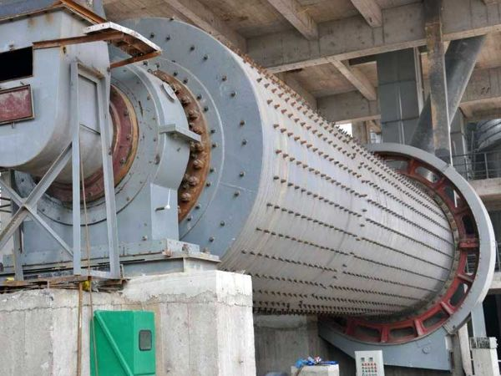
The next step is to proportion the raw materials according to a specific formula to create the desired chemical composition. This is done by weighing and measuring the raw materials and adding them to a mixer. The proportioning process is important because it determines the strength and other characteristics of the final product.
3
Raw Material Proportioning
The proportioned raw materials are then ground together in a raw mill to create a wet, slurry-like mixture. This mixture is then blended in a homogenizing silo to ensure that the chemical composition is consistent throughout the entire batch. The grinding process reduces the size of the raw materials even further, making it easier to handle and transport.
4
Raw Material Grinding and Blending

Slide 20
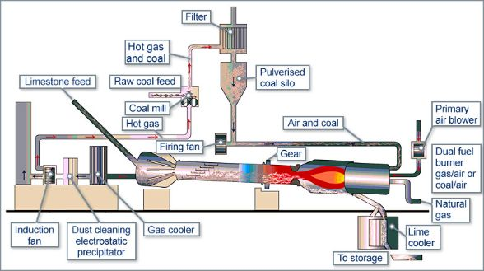
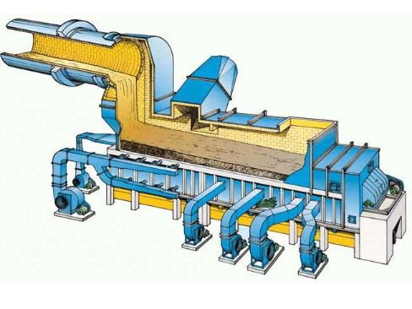
The wet mixture is then fed into a rotary kiln, which is a long, horizontal tube lined with firebrick. The kiln is heated to a high temperature, typically around 1450°C, which causes the raw materials to react and
form a hard, nodular material called clinker. The kiln operation is a critical step in the cement manufacturing process because it determines the final characteristics of the cement.
5
Kiln Operation
After being heated in the kiln, the clinker is cooled and transported to a storage area, where it is allowed to cool further. Cooling the clinker helps to prevent it from breaking down or becoming too brittle when it is ground into cement.
6
Clinker Cooling

Slide 21
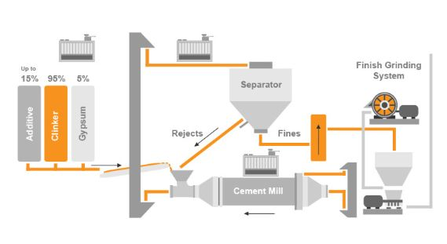
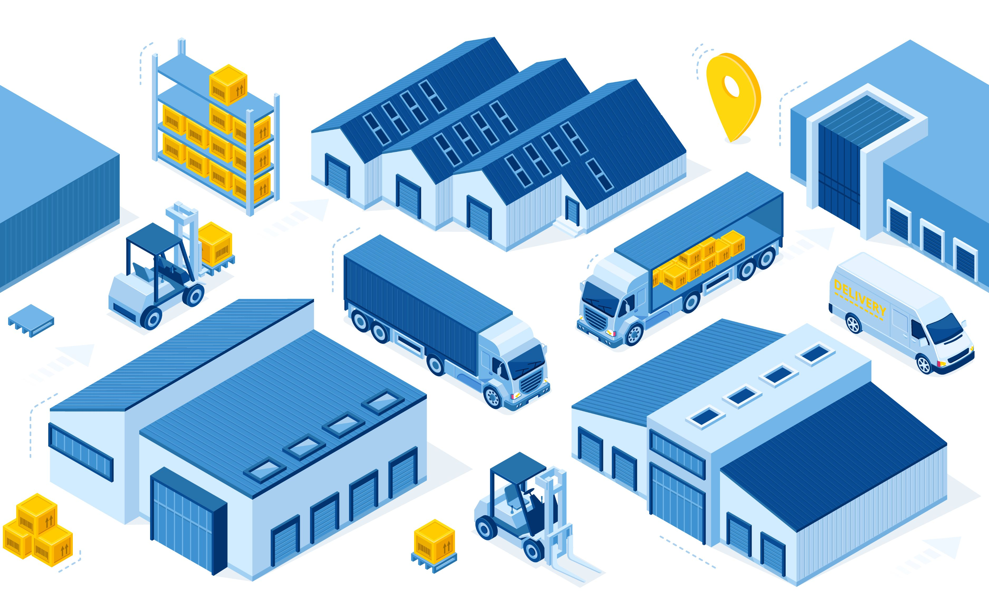

The cooled clinker is then ground in a ball mill or roller mill to produce fine powder. This powder is called Portland cement, and it is the final product of the cement manufacturing process. The grinding process reduces the size of the clinker even further, making it easier to handle and transport.
7
Clinker Grinding
The cement is then packaged in bags or bulk containers and shipped to construction sites or cement plants for use in the production of concrete. The packaging and shipping process is important because it ensures that the cement is delivered to the right location in a safe and timely manner.
8
Cement
Packaging
and Shipping

Slide 22


Overall Reactions
1. Limestone decomposes to give lime and CO₂
CaCO₃ CaO + CO₂
_{(lime)}
2. Lime obtained from limestone reacts with alumina and silica (obtained from clay and sand) to give calcium silicate and calcium aluminate.
2CaO + SiO₂ 2CaO.SiO₂
Dicalcium silicate (26%)
3CaO + SiO₂ 3CaO.SiO₂
Tricalcium silicate (51%)
3CaO + Al₂O₃ 3CaO.Al₂O₃
Tricalcium aliuminate (11%)
4CaO + Al₂O₃ + Fe₂ O₃ 4CaO.Al₂O₃.Fe₂O₃
Tetracalcium alumino ferrite (12%)
Constituents of Portland Cement

Slide 23


Now that we have a thorough understanding of the cement manufacturing process, let's shift our focus to the national scenario. Specifically, how the demand for cement has evolved in different countries over the past few years.

Slide 24

04
National
Scenario

Slide 25




Nepal is a small country with a population of about 29 million people. It has a relatively small cement industry, with a total production capacity of about 15 million tons per year. Cement consumption in Nepal has been increasing in recent years, but it is still relatively low compared to other countries in the region. Most of the cement produced in Nepal is used in the construction industry, which is the largest contributor to the country's economy.
The cement industry in Nepal is dominated by a few large companies, including Nepal Shalimar Cement, Udayapur Cement Industries, and Arghakhanchi Cement. These companies operate modern, state-of-the-art cement plants that use advanced technology and equipment to produce high-quality cement.
The cement industry in Nepal is expected to continue to grow in the coming years due to increasing demand for cement in the construction sector. The construction industry in Nepal is expanding rapidly, driven by factors such as population growth, urbanization, and economic development. As a result, there is a growing demand for cement to be used in the construction of new buildings, roads, and infrastructure projects.
Cement Production in Nepal
In addition to the growing demand for cement, the industry is also supported by favorable government policies and incentives. The government of Nepal has implemented a number of measures to promote the use of domestic cement and support the growth of the local industry. These measures include tax exemptions and subsidies for cement producers, as well as requirements for the use of domestic cement in government-funded construction projects.
Overall, the outlook for the cement industry in Nepal is positive, and it is expected to continue to grow in the coming years as demand for cement in the construction sector continues to increase.

Slide 26

The world's cement production has been steadily increasing over the past few decades, with China, India, and the United States being the top producers. In 2020, China alone produced more than 2.4 billion metric tons of cement, accounting for more than half of global production. India and the United States were the next largest producers, with production of 300 million and 110 million metric tons, respectively.
Cement Production in World
According to data from the Department of Mines and Geology, Nepal's cement production in 2020 was approximately 3.5 million metric tons. This represents a significant increase from previous years, with cement production in Nepal having reached 2.6 million metric tons in 2019 and 2.3 million metric tons in 2018.
Fig: Chart showing global cement production in 2020

Slide 27



Now that we have a sense of the overall landscape of cement production in the country and the world, let's delve deeper into the specific companies that are driving this industry forward.
What’s next?

Slide 28
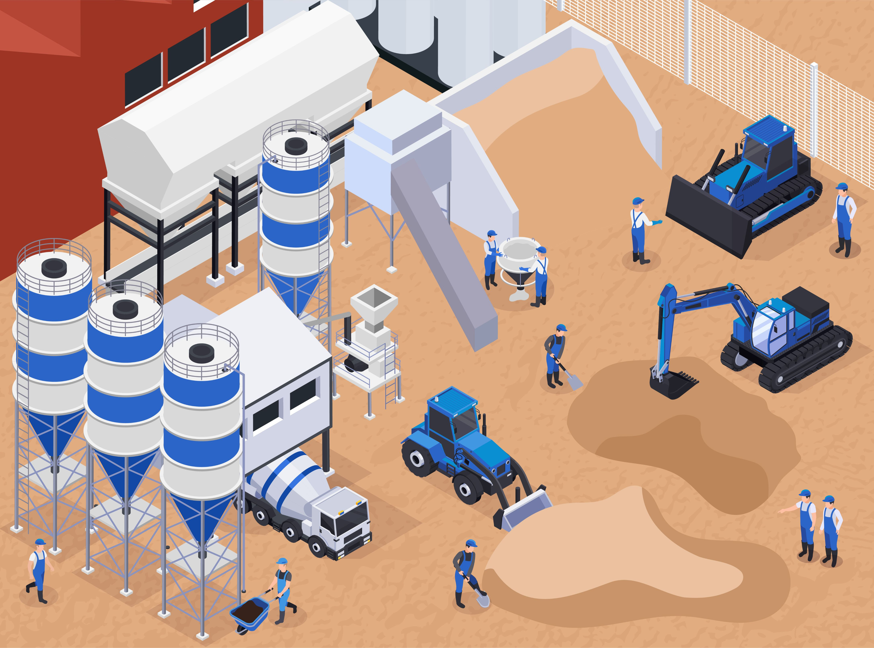
05
Manufacturers
&
Challenges

Slide 29





Previously, we have seen that the global cement industry is a multi-billion dollar market, with China, India, and the United States being the top producers.
However, in this section, we will also be focusing on the cement industry within our own country. While we may not be a global leader in cement production, we do have a number of domestic manufacturers that play a significant role in meeting the demand for this important building material. So let's take a closer look at the cement manufacturers that are shaping the industry both globally and nationally.
Cement Manufactures

Slide 30
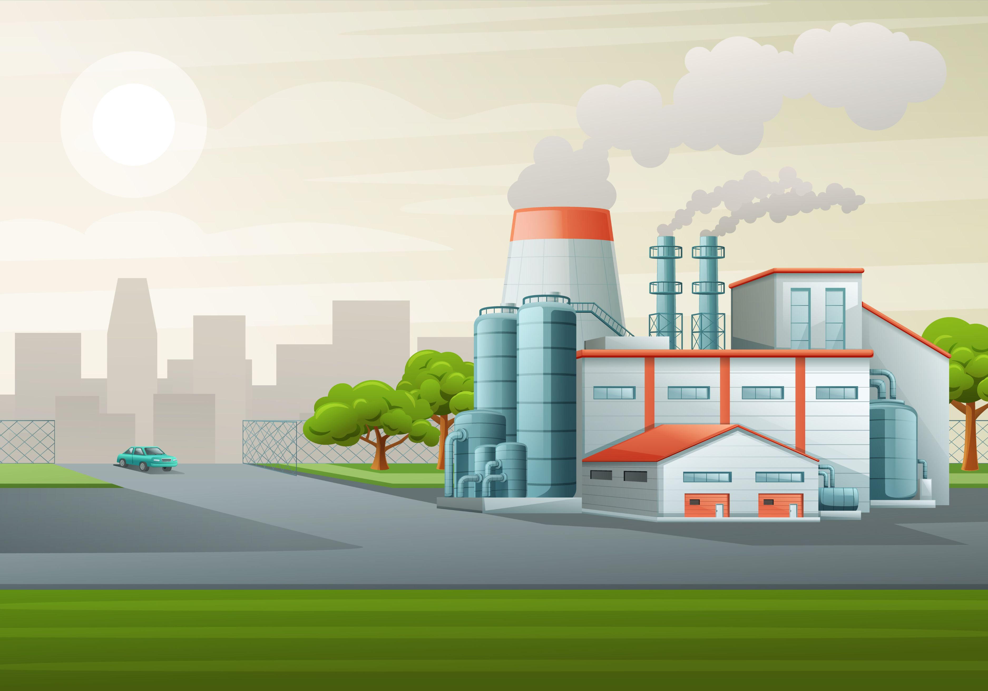
Cement
Manufacturers
In
Nepal

Slide 31


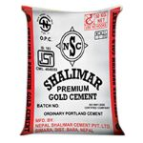

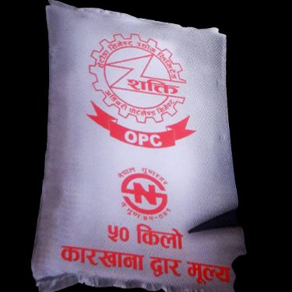

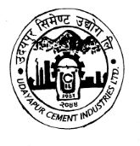
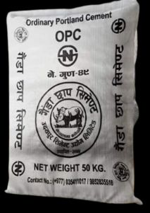

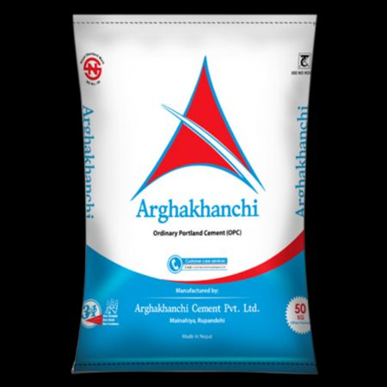
Cement Manufactures in Nepal
There are several cement companies operating in Nepal, and the top four producers are:
01
This company is one of the largest cement producers in Nepal, with a production capacity of 2,400 metric tons per day. It has a state-of-the-art cement plant located in Jhapa, Nepal.
Nepal Shalimar
Private Limited
02
This company is the second-largest cement producer in Nepal, with a production capacity of 1,500 metric tons per day. It has a cement plant located in Hetauda, Nepal.
Hetauda Cement Industries Limited
This company is the third-largest cement producer in Nepal, with a production capacity of 1,200 metric tons per day. It has a cement plant located in Udayapur, Nepal.
03
Udayapur Cement Industries Limited
04
This company is the fourth-largest cement producer in Nepal, with a production capacity of 900 metric tons per day. It has a cement plant located in Arghakhachi, Nepal.
Arghakhachi Cement Private Limited
Now let’s see what challenges these companies face.

Slide 32



Cement companies operate in a dynamic and complex industry that is subject to a range of challenges. These challenges can vary depending on the specific location and operating environment of a particular company. In Nepal, some of the key challenges faced by cement companies include the availability of raw materials, transportation issues, electricity supply, competition, and government regulations.
One of the major challenges faced by cement companies in Nepal is the availability of raw materials. Cement production requires a variety of raw materials, including limestone, clay, and gypsum. These materials may not always be readily available in Nepal, which can lead to difficulties in sourcing them and may increase production costs.
Challenges
Transportation can also be a significant challenge for cement companies in Nepal. As a landlocked country, it can be difficult to transport raw materials and finished products, which can increase the cost of production and distribution.

Slide 33



Electricity supply is critical for cement production, and Nepal often experiences power shortages. This can impact the operations of cement companies and may increase production costs.
Competition is also a key challenge in the cement industry in Nepal. There is strong competition among cement companies, which can make it difficult for new companies to enter the market and for existing companies to maintain market share.
Challenges
Finally, cement production can have environmental impacts, and companies may need to comply with various regulations and permits to operate. This can increase the cost of production and may pose challenges for cement companies in Nepal.
Now let’s see the ways to cope with these challenges.

Slide 34

06
Ways to
Cope With
Challenges

Slide 35



In light of the challenges faced by cement producers in Nepal, it is important for the industry to identify and implement strategies to cope with these challenges. Some potential ways to cope with these challenges include:
Developing domestic production: One of the main challenges faced by cement producers in Nepal is the limited domestic production, which makes the industry reliant on imported cement. To address this challenge, cement producers can invest in modern production technologies and expand their existing plants to increase domestic production. This can help reduce reliance on imported cement, create jobs and stimulate economic growth within the country. It can also help cement producers better respond to fluctuations in international prices and supply shortages.
Ways to Cope With Challenges
Improving infrastructure: Nepal's inadequate transportation infrastructure and lack of access to ports pose a challenge for cement producers in terms of sourcing raw materials and transporting finished products to market. Improving infrastructure, such as roads and ports, can help reduce the cost and time required to transport raw materials and finished products, which can improve the competitiveness of domestic cement producers. This can be achieved through investments in infrastructure projects, both by the government and private sector.

Slide 36



Adopting energy-efficient technologies: Nepal's relatively high energy costs can increase the cost of production for cement producers, making them less competitive. To address this challenge, cement producers can adopt energy-efficient technologies, such as waste heat recovery systems, which can help reduce energy consumption and lower production costs. This can be achieved through investments in technology upgrades and training for employees on energy-efficient practices.
Diversifying exports: Cement producers in Nepal face competition from imported cement, which is often cheaper due to economies of scale and lower production costs in the exporting countries. To cope with this challenge, cement producers can explore opportunities to diversify their exports to other countries in the region. This can help reduce reliance on a single market and mitigate the impact of fluctuating international prices. It can also help cement producers tap into new markets and expand their customer base.
Ways to Cope With Challenges
Accessing financing: Many cement producers in Nepal face difficulty in accessing financing for expansion and modernization, due to the high risk associated with the industry and the lack of collateral. To address this challenge, cement producers can seek out alternative financing options, such as crowdfunding or venture capital, which may be more flexible and have fewer requirements than traditional lending sources. The government can also play a role in facilitating access to financing for cement producers by providing guarantees or other forms of support. This can help cement producers fund expansion and modernization efforts and improve their competitiveness.

Slide 37



Conclusion
In conclusion, cement is a vital material for construction and infrastructure development, and its manufacture involves a complex process that requires a variety of raw materials and energy sources. The production of cement generates greenhouse gas emissions, and efforts to reduce these emissions and adopt more sustainable production practices are ongoing. The cement industry is subject to a number of challenges, including fluctuations in demand and supply, competition from foreign producers, and environmental regulations. To address these challenges and remain competitive, cement producers must adopt innovative technologies and practices to improve efficiency, reduce costs, and minimize environmental impacts. By continuously evolving and improving their operations, cement producers can contribute to the sustainable development of the industry and the global built environment.

Slide 38






‘The foundation of a strong structure is built with cement, just as the foundation of a strong presentation is built with hard work and dedication.
Sujan
Karki
Utsav
Acharya
Ashis
Kunwar
Arpan
Bhandari
Sujal
Bhattarai
Gopal
Mishra
Thank you for listening. - The Concrete Thinkers

